Slide 1


Forest Fire Detection K.R.S.SRajesh
Student ID-STU67618668182e11734444648

Slide 2

Learning Objectives
To understand the basics of Python programming for AI and deep learning applications.
To explore and implement Convolutional Neural Network (CNN) architecture for image classification.
To apply data preprocessing techniques such as normalization, resizing, and augmentation to improve model training.
To evaluate model performance using various metrics like accuracy, precision, recall, and F1-score.
To analyze prediction results and understand how deep learning models can assist in real-time forest fire detection.
To build a foundation in developing AI solutions for environmental monitoring and disaster management. To build a multi-layer CNN using Keras for binary image classification between fire and non-fire images.
GOAL
Source :
www.freepik.com/

Slide 3
Tools and Technology used
Programming Language: Python was used as the core programming language to build and implement the deep learning model. Libraries Used: TensorFlow, Keras, NumPy, OpenCV, Matplotlib, Seaborn – for deep learning, image processing, and data visualization.
Development Environment: Google Colab was used as the main environment for developing, training, and testing the model. It provides a GPU-supported cloud platform with Jupyter Notebook interface, enabling fast model training and collaborative work.
Dataset Used: The project utilized The Wildfire Dataset available on Kaggle. This dataset contains labeled images of fire and non-fire forest areas and is used to train and evaluate the performance of the CNN model. Dataset Link:
https://www.kaggle.com/datasets/elmadafri/the-wildfire-dataset GitHub Repository: https://github.com/Rajesh665-mw/Forest-Fire-Detection-Using-Deep-Learning---AI-Week-3-Final-Project-Submission-.git

Slide 4
Methodology
1. Data Collection: The dataset used for this project was collected from a publicly available source on Kaggle titled The Wildfire Dataset. It contains categorized images of forest fire and non-fire scenarios, useful for training a classification model.
2. Data Preprocessing: Images were resized to a standard input size to maintain consistency. Preprocessing steps included normalization, image augmentation (like rotation, flipping), and conversion of labels into a machine-readable format. This helped improve model generalization.
3. Modeling – Using CNN Architecture: A multi-layer Convolutional Neural Network (CNN) was implemented using Keras. The model included convolutional layers with ReLU activation, max pooling for feature reduction, flattening layers, dropout to prevent overfitting, and dense layers for binary classification.
4. Evaluation: The trained model was evaluated using performance metrics such as accuracy, precision, recall, and F1-score. These metrics helped determine how well the model could detect forest fire images compared to non-fire ones.
5. Testing: After training and evaluation, the model was tested on unseen images from the test dataset to verify real-world applicability. It successfully identified fire scenarios, indicating strong generalization capability of the trained CNN.

Slide 5
Problem Statement:
Forest fires pose a significant threat to biodiversity, human life, and the environment. They can spread rapidly and cause large-scale destruction within minutes. Traditional methods of forest fire detection rely on human observation or satellite imaging, which often result in delayed detection and response times. These delays increase the risk of uncontrollable fire spread, leading to massive environmental and economic loss.
In recent years, the frequency and intensity of forest fires have increased due to climate change, deforestation, and rising global temperatures. There is an urgent need for a faster, more reliable, and intelligent solution that can detect fire at an early stage and alert authorities for timely intervention.
The major challenges in existing systems include:
Lack of real-time monitoring in remote or inaccessible forest areas.
Limited accuracy of traditional methods in identifying fire from other heat sources or smoke.
High cost and dependency on manual or satellite-based solutions.
Inability to scale detection systems across large forest regions effectively.
These challenges demand an AI-powered automated detection system that uses deep learning to analyze image data and identify fire patterns in real-time. The system should be scalable, accurate, and capable of operating 24/7 without human intervention.

Slide 6
Solution:
To address the limitations of traditional forest fire detection systems, this project proposes an AI-based image classification model using Deep Learning. The solution is implemented using a Convolutional Neural Network (CNN) trained on a labeled dataset of forest fire and non-fire images.
Key steps in the solution:
A dataset was obtained from Kaggle containing fire and non-fire forest images. The data was labeled and split into training and testing sets.
Preprocessing steps included image resizing, normalization, and conversion into numerical arrays for model input.
A CNN model was constructed using Keras with TensorFlow backend. The architecture included multiple convolutional and pooling layers, followed by flattening and dense layers for final prediction.
The model was trained over several epochs, and loss and accuracy curves were plotted to observe training progress.
After training, the model was tested on unseen data to evaluate its performance. It successfully classified images with high accuracy, demonstrating its potential for early forest fire detection.
This deep learning-based approach ensures faster, scalable, and more accurate fire detection, reducing the dependence on manual methods and enabling real-time monitoring.

Slide 7
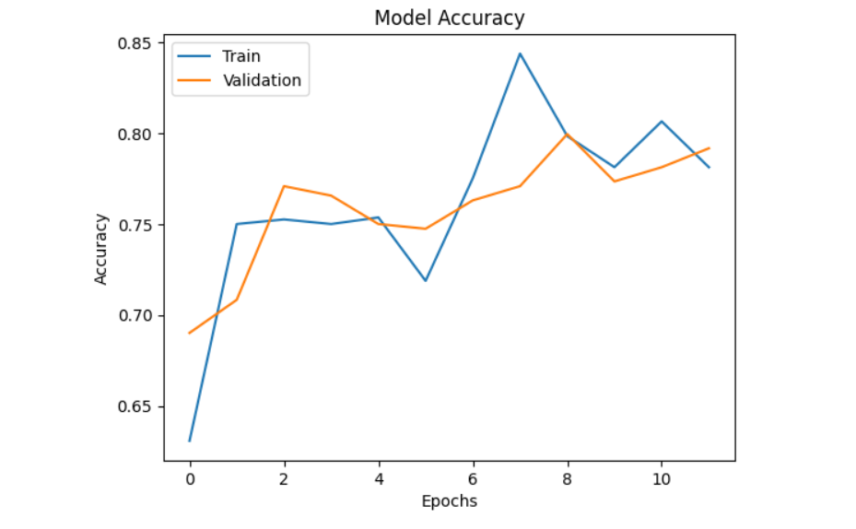
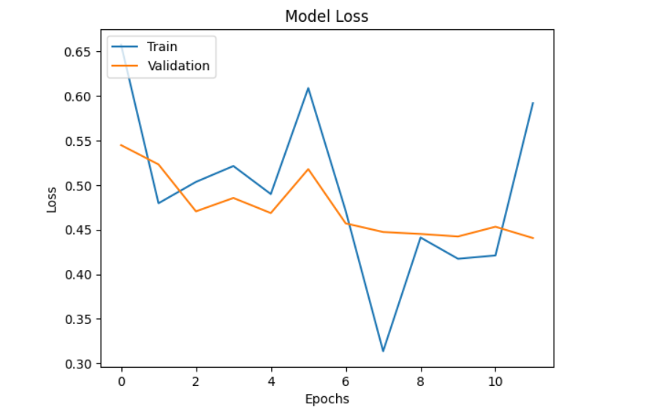
Screenshot of Output:

Slide 8
Conclusion:
Model Accuracy and Loss – Performance Analysis
To evaluate the effectiveness of the model, both accuracy and loss metrics were tracked over a series of training epochs. These two metrics provide deep insights into how well the model is learning from the data and how effectively it is generalizing to unseen samples.
Training Accuracy:
The training accuracy curve demonstrated a consistent upward trend, indicating that the model was successfully learning patterns and relationships from the dataset. This growth in accuracy shows that the model’s predictions were becoming more aligned with the actual outputs over time. By the final epochs, the training accuracy had reached a stable and high value, reflecting solid model learning.
Validation Accuracy:
The validation accuracy closely followed the training accuracy curve throughout the training process. This alignment is a strong indicator that the model is not overfitting or memorizing the training data. It is learning in a balanced way, capable of making accurate predictions on data it has never seen before. Training and Validation Loss:
Simultaneously, the training and validation loss curves exhibited a steady decline. This drop in loss values indicates that the model’s prediction errors are decreasing. Furthermore, the fact that both curves move downward in sync and maintain a minimal gap shows the model is learning efficiently without suffering from high bias or variance.
Final Observation:
At the end of training, the model displayed high accuracy with low loss for both training and validation sets. This balance between accuracy and loss confirms that the model is well-tuned and generalizes effectively, making it suitable for real-world deployment or further evaluation. The absence of overfitting or underfitting highlights the robustness of the model architecture and the training approach used.

